Slide 1
BAYLOR COLLEGE OF MEDICINE BIOTECH ACADEMY AT RUSK
Athletics

Slide 2
Sports Physicals
Dear Parents/ Guardians,
Houston Independent School District requires yearly physical examinations when students participate in school sports. You may either have the exam complete by your personal physician or Dr. Howard from Better Days Chiropractor Clinic will provide exam at BCM Biotech Academy at Rusk. If your child needs to have a sports physical completed at school, please send in completed athletic forms along with $20.00 cash to Mrs. Schneider by Monday, September 11, 2024.
Sports physicals will be completed on the following date:
Thursday, September 14, from 2:30pm-4:00pm.
All completed sports physicals will be due on Thursday, September 14, by 4:00PM. Your child will not be able to participate in after school activities until their athletic packet has been turned in. If you have any questions, please email me at Lisa.Schneider@Houstonisd.org. We are excited that your child is considering being part of our athletic after school programs for the upcoming 2023-2024 school year.
Sincerely,
Lisa Schneider

Slide 3
Soccer Coaches: Mr. Munoz & Mr. Sirias
Boys will practice during flex period A once they begin
Girls will practice during flex period B once they begin
Try outs will be during:
Boys: Flex period A
Girls: Flex period B
Tryouts will be during flex periods once they begin
After-school practices will be on Fridays from 4-5PM. First practice: TBD.

Slide 4
Volleyball Coach: Mrs. Salazar
Tryout will be on Tuesday, September 26
Season will last until Tuesday, November 14th
Monday’s & Tuesday’s 4:00PM-5:00PM
Practice begins Monday, October 2
Bring with you to practice: knee pads, shorts, t-shirt, tennis shoes, water bottle & snack

Slide 5
Cheerleading Coach: Ms. Jackson
Begins: September 19
Tuesday and Thursday
4:00PM-5:15PM
Bring change of clothing, tennis shoes, water bottle and snack

Slide 6
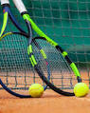
Tennis Coach: Ms. Hernandez
September 21 –December 14
Thursday’s
4:00PM-5:15PM
Bring tennis shoes, change of clothing, water bottle and snack.

Slide 7
Brain STEM Mr. Umeh
September 19- end of school year
Tuesday’s
4:00PM-5:15PM

Slide 8
Dance Coach: Ms. Terry
September 26-May 23
Tuesday & Thursday’s
4:15PM-5:30PM
Try-Outs: 9/26-9/29 team roster will be posted on 10/2
Need: black top and black bottoms, tennis shoes or dance shoes, hair tied or pulled up, snack and water bottle

Slide 9
Boxing Club Coach: Mr. Johnson
September 19-May 23
Tuesday & Thursday’s
4:00PM-5:00PM
Bring a change of clothing, tennis shoes, boxing gloves, hand wraps, snack and water bottle
**There will be no actually boxing in class. This is a workout class.

Slide 10
Robotics Sponsors: Situka, Sirias, Hernandez, Feuk, Colangoy
September 27- May 22
Wednesday’s & Thursday’s
4:00PM-5:15PM
Night of the Sciences/ Noche De Ciencias: October 12 5:00PM-7:00PM

Slide 11
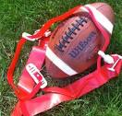
Flag Football Coaches: Bakare, Pulu, Tolbert
Practice will be on Tuesday & Thursday’s
4:00PM-5:00PM
September 26-November 14
More details will be provided soon ……………..

Slide 12
Houston 5K Practice and Run Coaches: Mrs. Schneider & Mr. Munoz
Practice begins on Monday, October 2
Monday’s & Wednesday’s
7:30AM-8:15AM
Parents MUST be able to bring you to the GRB to run the Houston 5K on Saturday, January 13 at 7:00AM
Wear running shoes, comfortable clothing, water bottle, school uniform

Slide 13
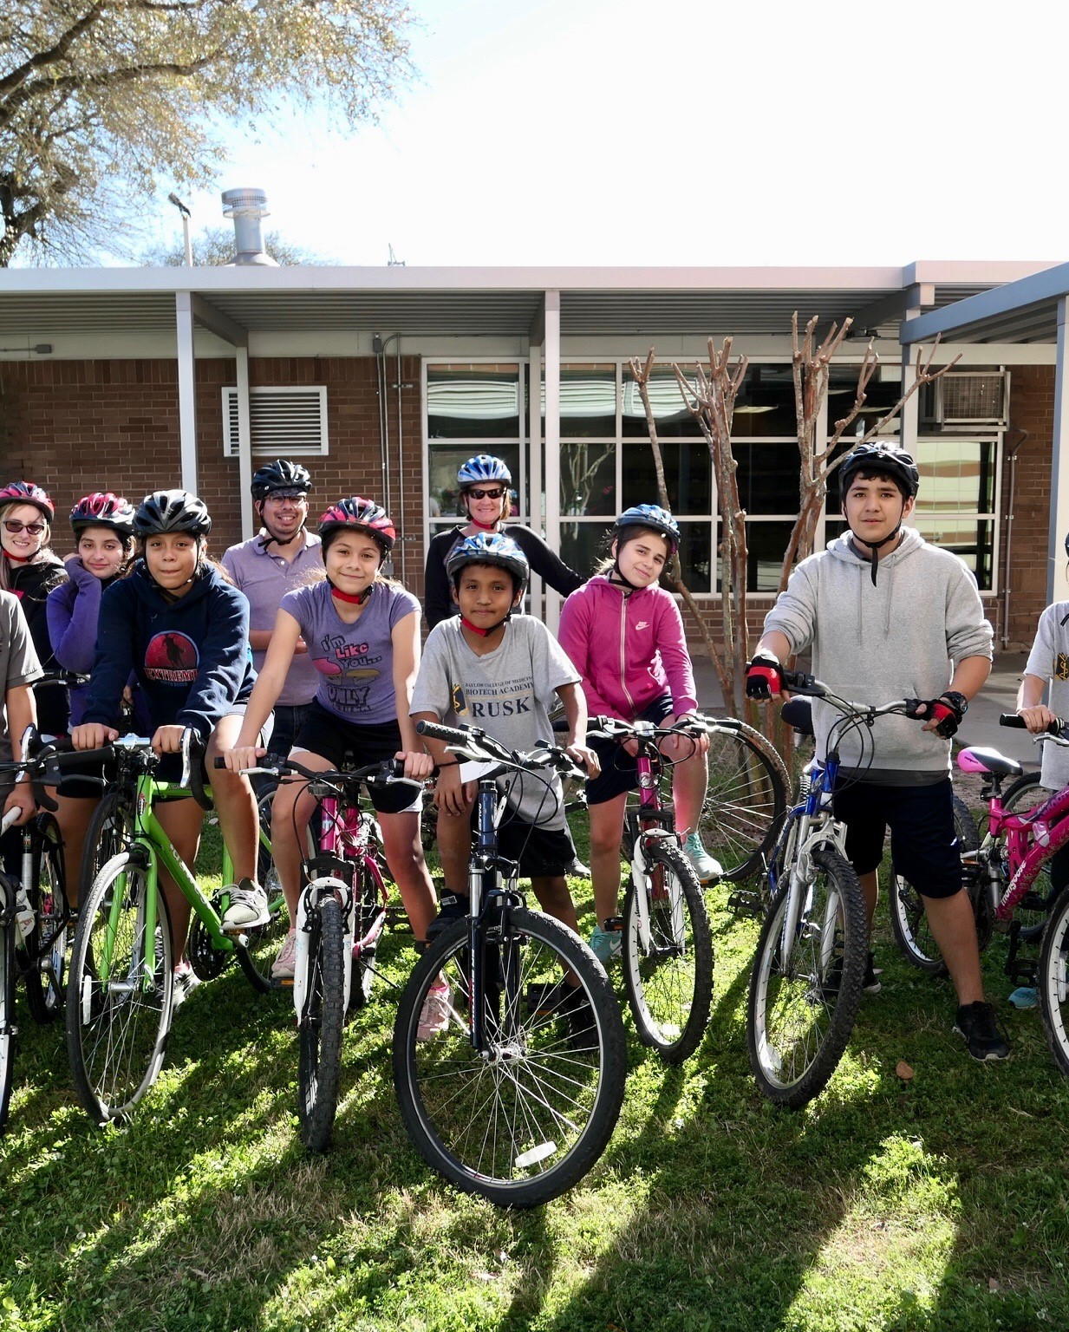
BCM Cycling Team Coaches: Mrs. Schneider, Ms. Edwards, Mr. Feuk, Ms. DeLaRosa
Cycling will be on Monday& Wednesday beginning
September 27 4:00PM-5:15PM
Parents Meeting:
Sept. 27 5:15
**** Full****

